Slide 1
Introduction to voltdb
- Amey manjrekar

Slide 2
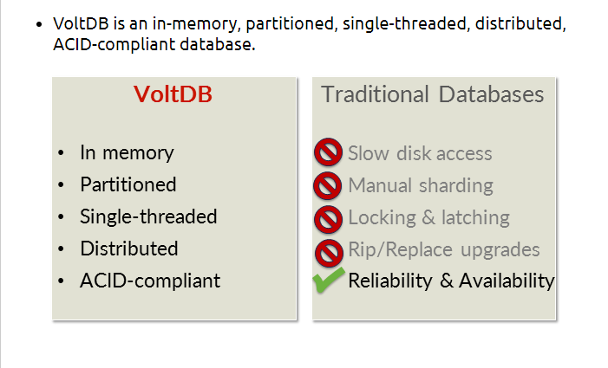
What is VoltDB

Slide 3
Features of Voltdb
In Memory
• Designed from the ground up to take advantage of modern computer architectures, VoltDB performs all processing in memory eliminating the delays and contention associated with traditional disk-based systems.
• Durability features such as snapshots, command logging, and database replication ensure your data is never lost due to system failure.
Partitioned
• Throughput is maximized by partitioning both the data and the transactions that access that data. So multiple transactions can be processed in parallel
• Throughput is easily scaled by increasing either the number of partitions per node or the number of nodes in the cluster.

Slide 4
Features of Voltdb
Single-threaded
• Each partition is single-threaded, running transactions to completion.
• Since there is no contention within the thread, VoltDB eliminates the need for locking and latching of database records and much of the associated management overhead that consumes traditional databases.
Distributed
• Distributing the partitions over a cluster allows VoltDB to easily scale both for performance (more partitions) and volume (more memory capacity).
• Clustering also provides durability and availability:
• K-Safety replicates partitions within the cluster, protecting the database against individual node failures.
• Database replication creates a duplicate copy of the entire database, providing disaster recovery and allowing for off-loading of read-only workloads.

Slide 5
Features of Voltdb
ACID-Compliant Database
• VoltDB is a fully ACID compliant database.
• Unlike NoSQL solutions, VoltDB provides the necessary performance without sacrificing the reliability and integrity of a fully transactional database system.
• Standard SQL syntax for both schema definition (DDL) and queries makes programming VoltDB applications easy.
• Simple SQL queries or more complex Java-based stored procedures provide the transactional units that succeed or roll back as required for reliable online transaction processing.

Slide 6
VoltDB Architecture
Database Schema
Partitioning
Cluster and Availability

Slide 7
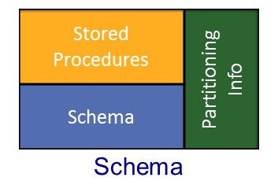
Database schema
At the heart of every VoltDB database is the schema, which defines:
• Stored procedures
• Partitioning information
• Tables, views, indexes, etc.

Slide 8
Starting database
The schema specifies the logical partitioning of table and store procedure.
The deployment file specifies size of cluster and how many partitions created on cluster.
Once database started we can provide SQL for creating tables.

Slide 9
Partitioning
VoltDB works by partitioning tables across cluster based on values of user-defined column.
It also partition work based on same column value.
As partitions are independent we can run multiple queries in parallel.
For multi partition query, partitions coordinate with each other. It will impact on performance.
Small, mostly read-only tables can be replicated. This allows replicated table available for each partition and improve performance.

Slide 10
Clusters & high-Availability
VoltDB can have multiple partitions on a single server, controlled by “sitesperhost” setting.
A site is a single-threaded SQL execution engine that store data and execute SQL statements for one partition.
We can also use multiple servers to replicate partitions (k-safety) to increase availability.
One partition runs on multiple sites for redundancy.

